Slide 1

BITN Group Undergraduate research Midterm symposium
Name: Ian Knight
Date: 03/03/2023

Slide 2
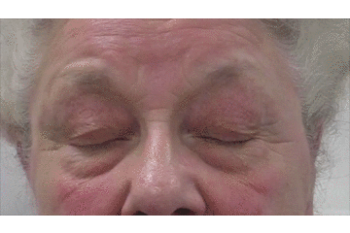

Project overview
Subtypes
Flutters
Full/Partial
Apraxia of eyelid opening
Upper facial spasm
Lower facial spasm
Both spasm
Title: Deep phenotyping in blepharospasm (BSP)
Aim: classifying subtypes of BSP using EOG/EMG
Tasks
A Designing and fabrication of new patch-type device
B Unsupervised pattern discovery
Sample image
https://mrdavidcheung.com/functional/blepharopspasm.html
Why unsupervised learning?
In the diagnosis of BSP, inconsistent diagnosis criteria from doctor-to-doctor introduces variation in outcomes for BSP diagnosis largely owing to human element.
Unsupervised learning methods do not require a ground truth to map data onto; they identify patterns in data un-augmented.

Slide 3
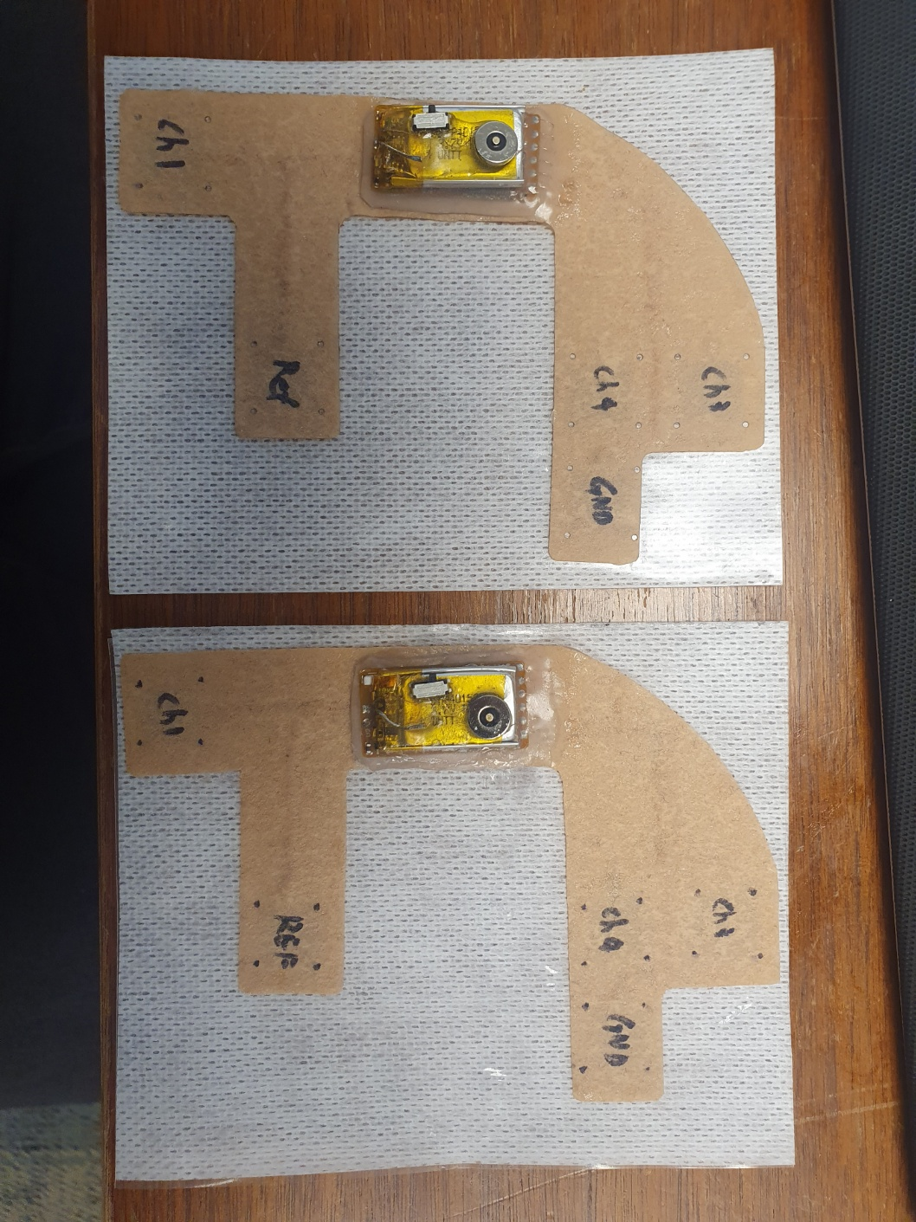
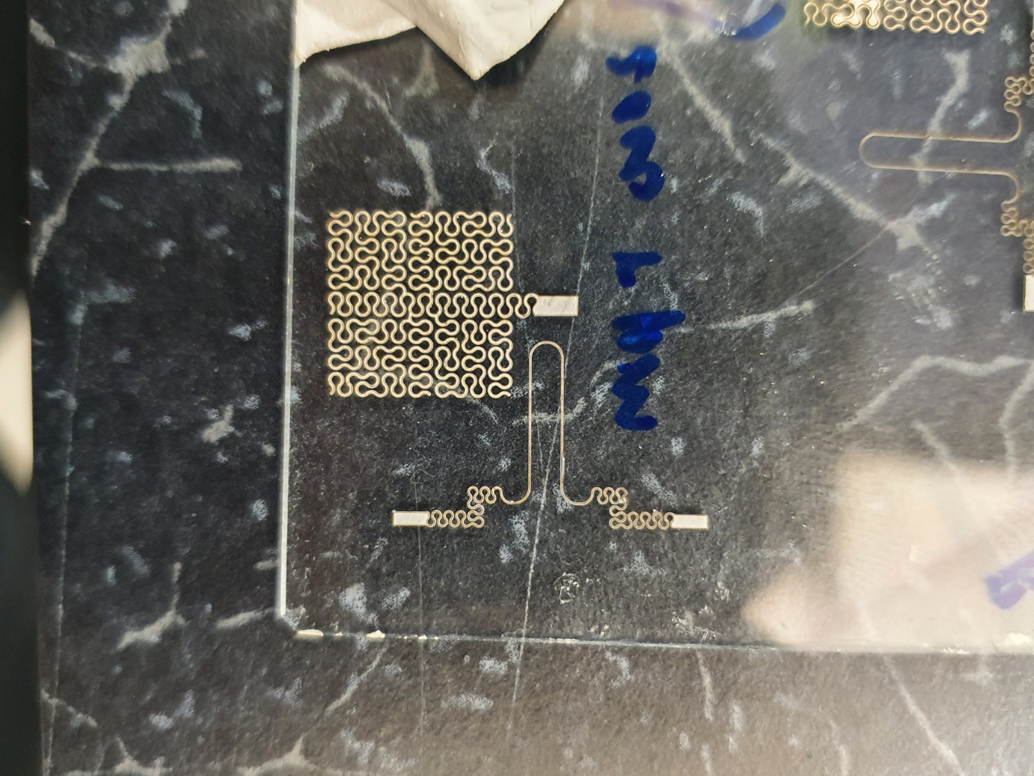
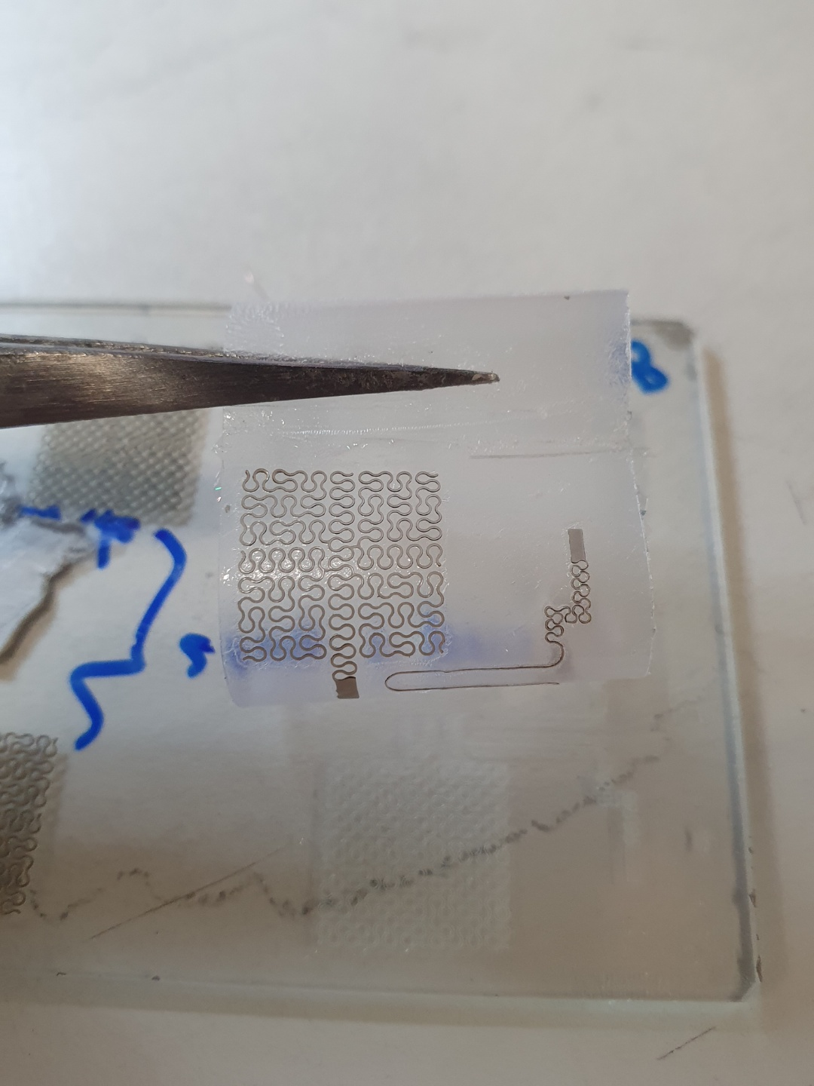
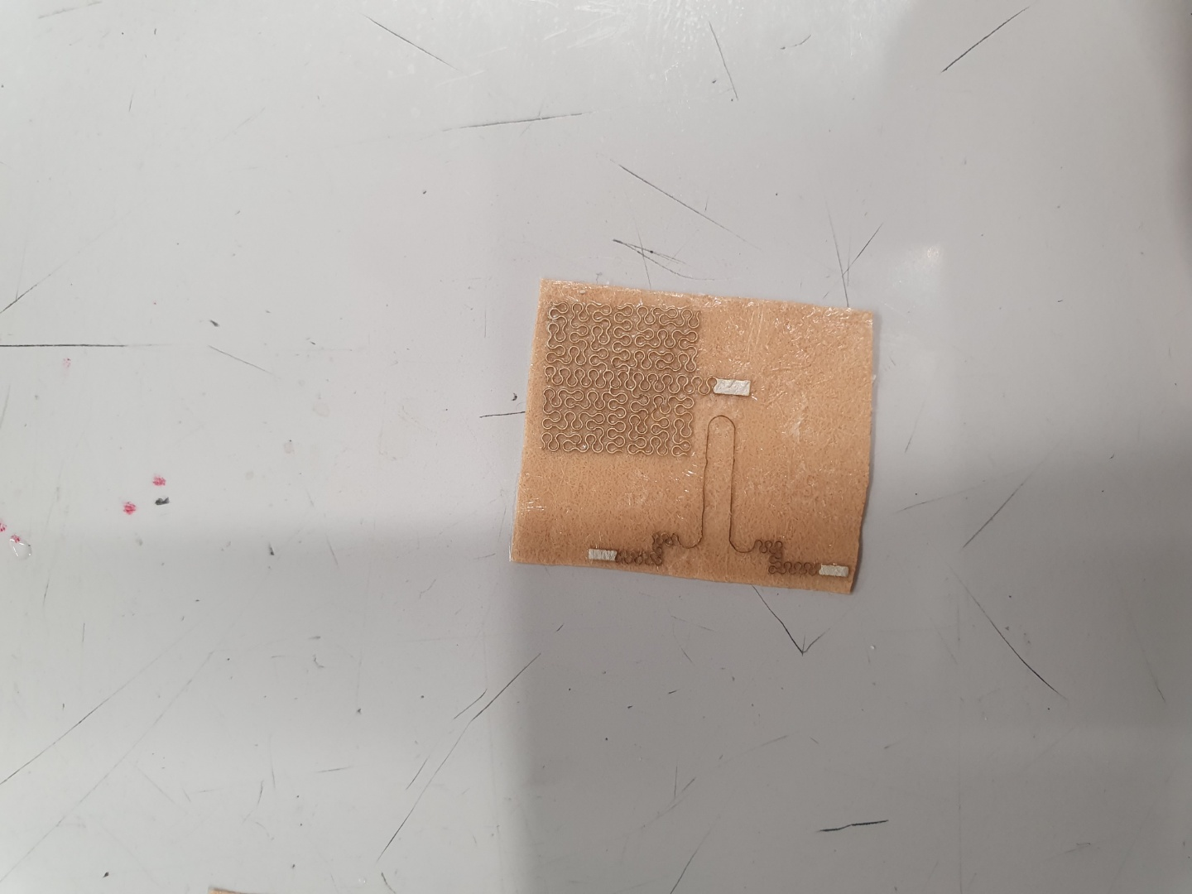
A : Designing and fabrication of new patch-type device
I started with in-lab fabrication of physical devices recently.
Practiced assembly of flexible-backing boards.
Have not fabricated any real devices.
Laser patterning
Transfer using water soluble tape

Slide 4
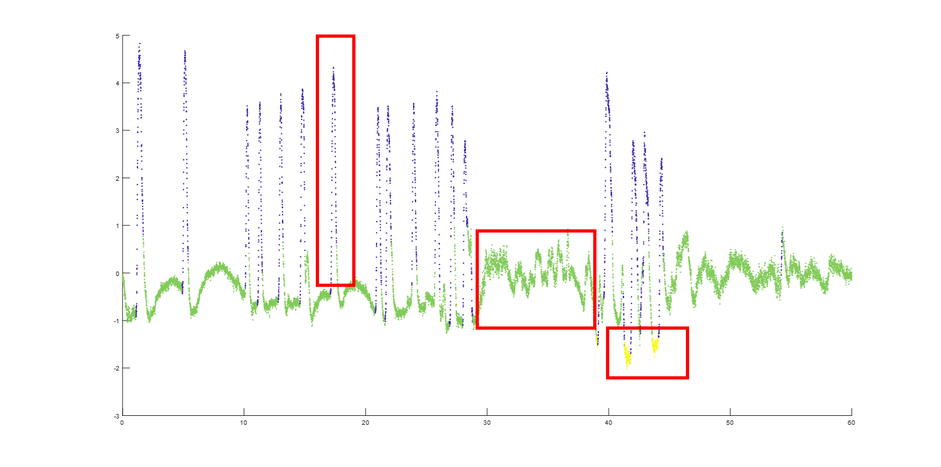
B : Unsupervised pattern discovery
Representative example
Current data is single-channel, timeseries
Anticipated data is multi-channel, timeseries
EOG+EMG
Time

Slide 5
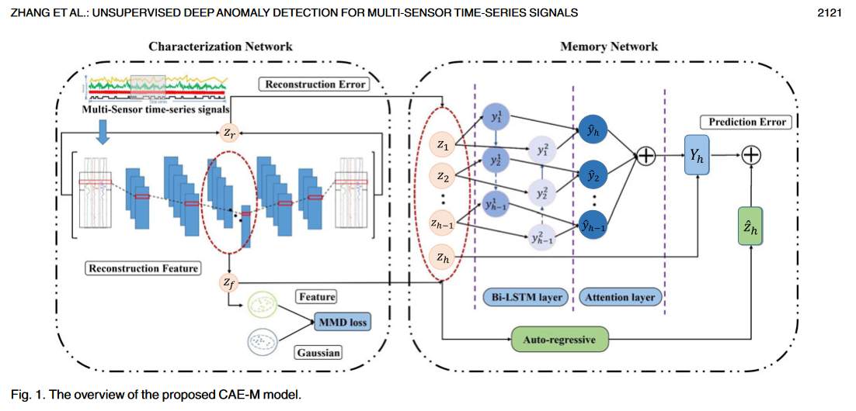
Attempt 1 : CAE
My work:
I implemented the characterization network, a CAE
We moved on from this implementation.
Conventional clustering methods (K-means, Gaussian Mixture, Kernel Density) are ill-suited to temporal signals
Anomaly detection model, not clustering model
Autoencoder maps the latent space in a continuous manner, the data points that are from the same cluster must be mapped together.
Autoencoders fail to hold the assumption of continuity in the latent space. VAEs may be better?

Slide 6
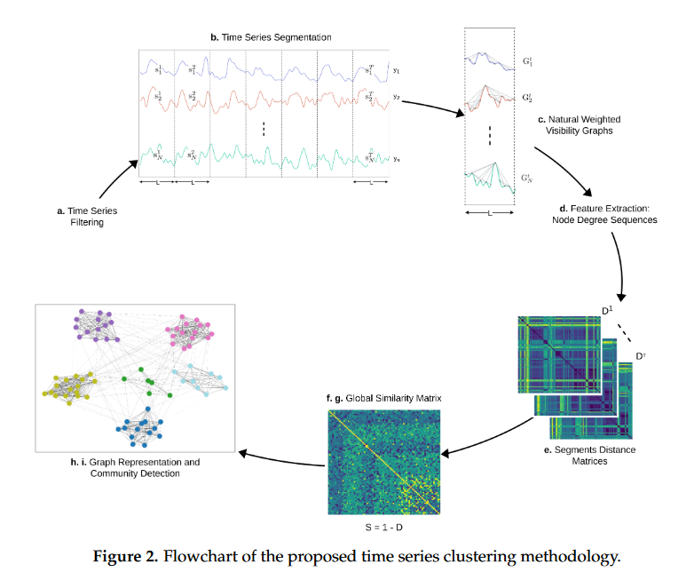
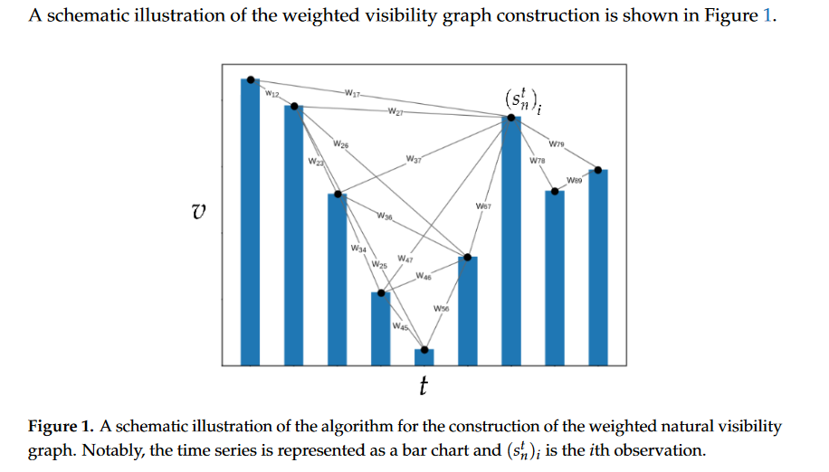
Attempt 2 : Natural weight visibility graphs
It is possible to convert timeseries into graph with a visibility graph.
A feature vector can be extracted from this graph.
That feature vector can then be used to cluster the data.
Weighted includes their distance as edge length

Slide 7
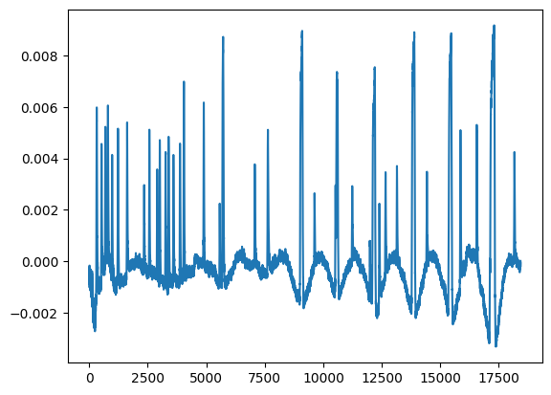
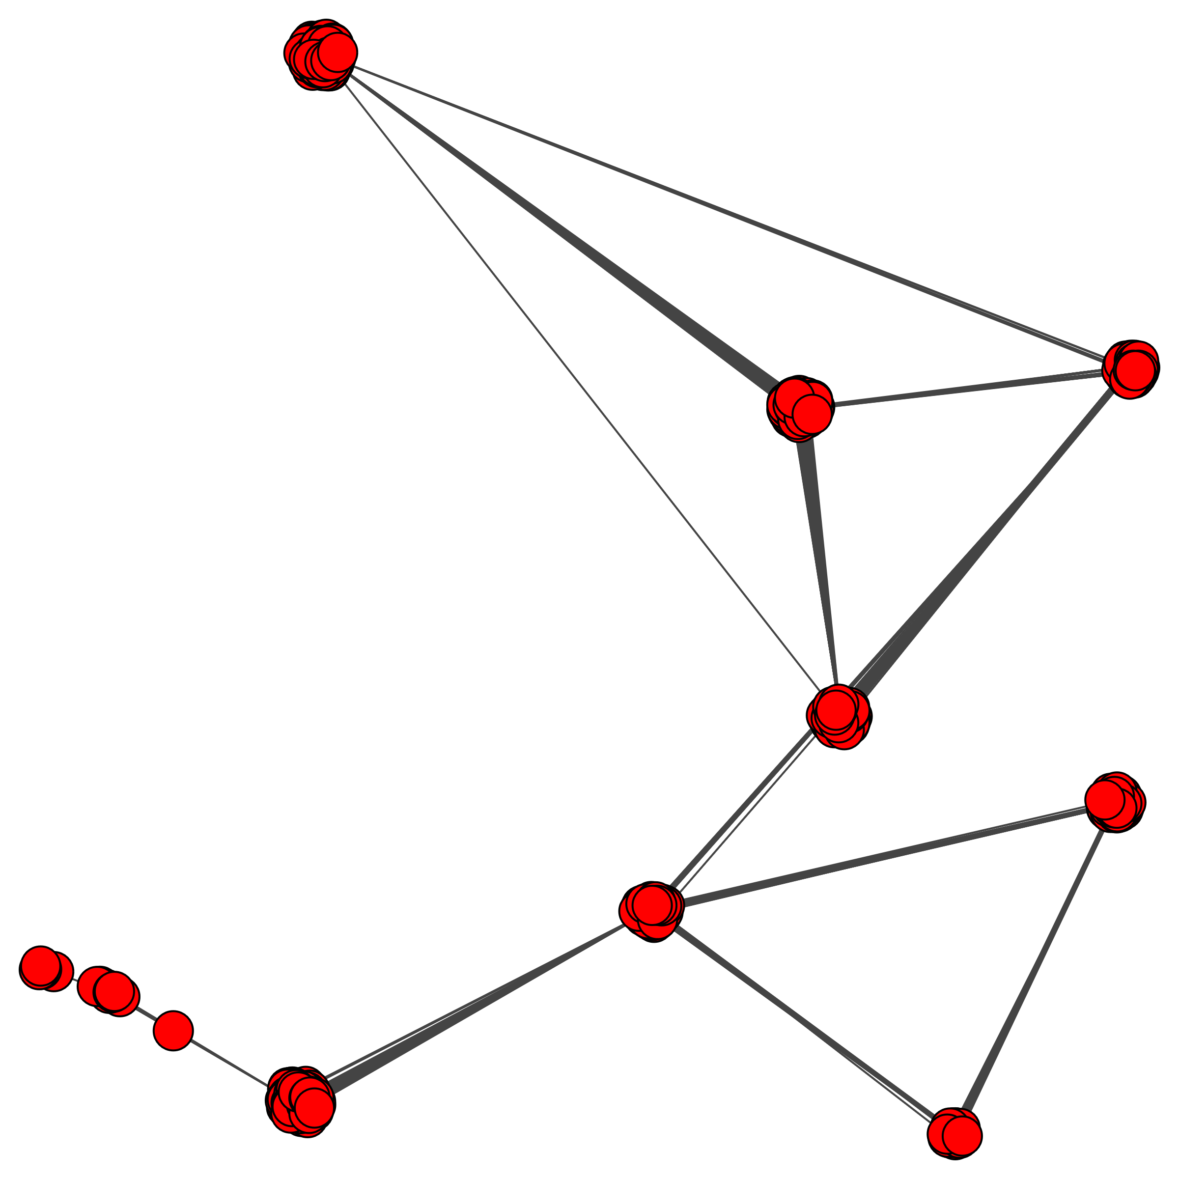
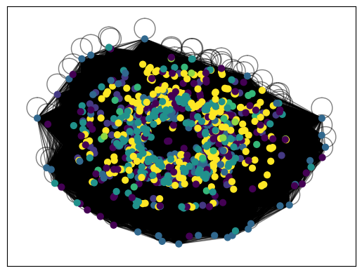
Quick Plots Slide
Data segment
Visibility graph
Distance matrix
Distance matrix containing distance of each node from every other node (N x N)
Initial result, does not make much sense. Original algorithm clustered entire signals, so changes must be made to logic.
Convert distance matrix to “similarity matrix” then to weighted graph, then Louvain algorithm for clustering

Slide 8
Challenges
Representative example
Developing with single-channel data, for a multi-channel purpose
EOG+EMG
Temporarily generating random data/multiplying current data for dummy channels
Time
My understand of structures, implementing new models from scratch is difficult.

